Slide 1
Contract Negotiations Survey
NAGE 2019 State

Slide 2
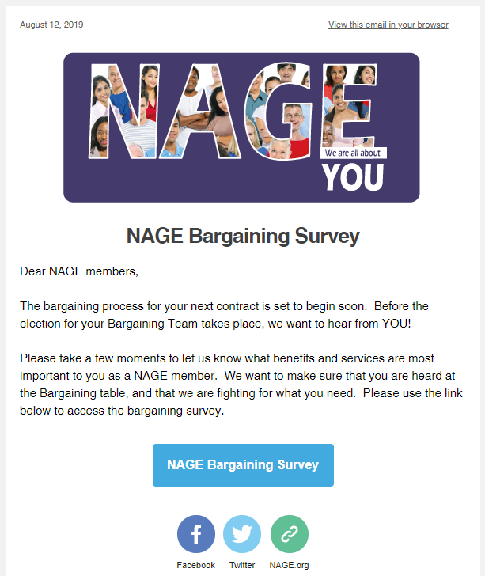
Contract Negotiations Survey
Distributed to State on August 19th
Kept open for one month
2,540 members replied in the first 24 hours
3,772 members replied overall!
Highest electronic member participation
we have ever had!

Slide 3
WAGES Rank the following wage-related issues in order of importance to you:
STATE
Cost of Living Adjustments (Raises)
Salary-Based Step Raises (Raises based on years of service)
Internal Career Ladder/Promotional Opportunities
Over-time Pay

Slide 4
BENEFITS Rank the following benefits in order of importance to you:
STATE
Retirement/Pension
PTO/Vacation/Sick Days
Alternate Work Options
Flex Time
Reclassification/Upgrades
Family-friendly Work Schedules
NAGE Union Representation
Training & Education
NAGE Legal Representation
Mileage/Travel Reimbursement

Slide 5
CAREER DEVELOPMENT Rank the following Career Development benefits in order of importance to you:
STATE
Tuition Remission
Online Classes
Class Credits
(towards advanced degree)

Slide 6
HEALTH CARE Rank the following Health Care issues in order of importance to you:
STATE
Contribution percentage for health care premium
Co-pays
Optical/Dental/
Dependent Care

Slide 7
HEALTH & SAFETY ON THE JOB Rank the following Health & Safety issues in order of importance to you:
STATE
Security in the workplace
Mutual respect, Article 6A
Healthy Workplace Legislation (Anti-bullying)
OSHA Protections

Slide 8
Additional Comments, Questions & Requests
Add additional steps for those who have maxed out
More member involvement in the negotiations process
Wider reach on bereavement leave (Aunts, Uncles, etc.)
Management review system

